Slide 1
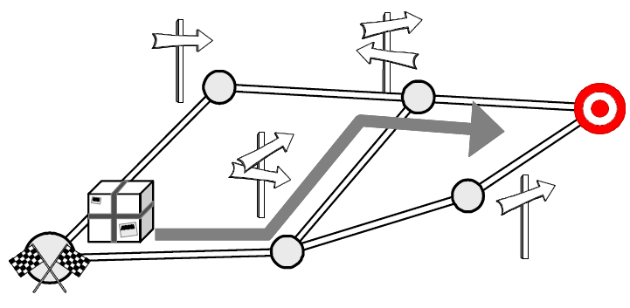
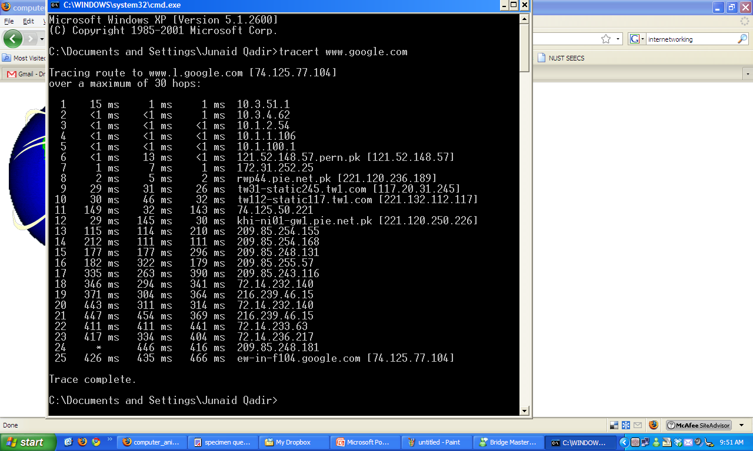
Topic 3; Lecture 2
How to route packets?
Notes:
In the previous lectures, we have assumed that the switches and routers have enough knowledge of the network topology so they can choose the right port onto which each packet should be output. In the case of virtual circuits, routing is an issue only for the connection request packet; all subsequent packets follow the same path as the request. In datagram networks, including IP networks, routing is an issue for every packet. In either case, a switch or router needs to be able to look at the packet’s destination address and then to determine which of the output ports is the best choice to get the packet to that address. As we saw in previous lectures, the switch makes this decision by consulting a forwarding table. The fundamental problem of routing is, How do switches and routers acquire the information in their forwarding tables?

Slide 2
Topic’s objectives
To learn about:
1 – Static vs. Dynamic Routing
2 – Scalable Hierarchical Routing
3 – Distance Vector Routing Protocols

Slide 3
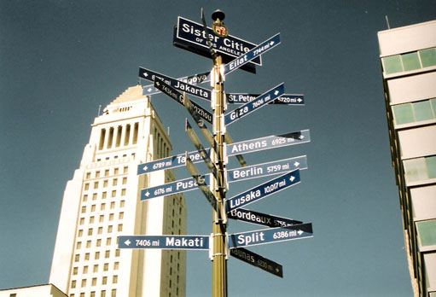
Routing

Slide 4
Network Layer- Routing
The main task of any network layer is routing
Route: [m-w.org] Inflected Form(s): rout·ed; rout·ing 1 : to send by a selected route : DIRECT <was routed along the scenic shore road> 2 : to divert in a specified direction

Slide 5
Network Layer-Routing
The main task of the network layer is routing
Route packets from a source to a destination using as few hops as possible
Each router maintains and periodically updates a routing table
Routing information is shared among routers
Routing algorithm

Slide 6
Optimization Goals
General answers appear impossible, but a few aspects should be considered
– Quality of Service
– Energy Efficiency [Now Energy Provisioning]
– Scalability
– Robustness

Slide 7
Classification of Routing protocols
Routing Protocols
Based on Routing information update mechanisms
Based on use of temporal information for routing
Based on topology information organization
Based on utilization of specific resources
Flat Routing
Hierarchal Routing
Table driven Proactive
On demand Reactive
Hybrid
Path selection using Path history
Power Aware Routing
Routing with efficient flooding
Notes:
In a flat routing infrastructure, each network ID is represented individually in the routing table. The network IDs have no network/subnet structure and cannot be summarized. RIP-based IPX internetworks use flat network addressing and have a flat routing infrastructure.
In a hierarchical routing infrastructure, groups of network IDs can be represented as a single routing table entry through route summarization. The network IDs in a hierarchical internetwork have a network/subnet/sub-subnet structure. A routing table entry for the highest level (the network) is also the route used for the subnets and sub-subnets of the network. Hierarchical routing infrastructures simplify routing tables and lower the amount of routing information that is exchanged, but they require more planning. IP implements hierarchical network addressing, and IP internetworks can have a hierarchical routing structure.
In hierarchical routing infrastructures, the internetwork can be divided into routing domains (also known as regions or areas). A routing domain is a collection of contiguous networks connected by routers that share the routing information for the routes within the domain. Routing domains are connected by a common routing domain called the backbone. Intra-domain routing is performed by the routers within the domain. Inter-domain routing is performed by domain routers connected to the backbone.

Slide 8
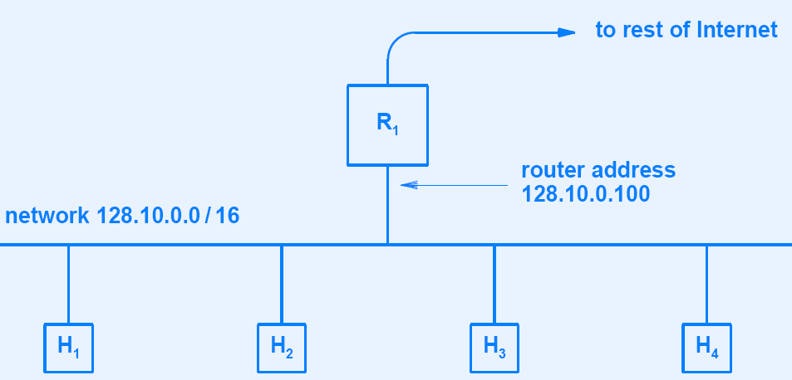
Static Routing
128.10.0.1/16
128.10.0.2/16
128.10.0.3/16
Notes:
In static routing algorithms, routes change very slowly over time, often as a result of human intervention (for example, a human manually editing a router’s forwarding table).
As an IP address is configured on an interface, information about its own network gets added automatically to the routing table. For example, in the figure above, if we configure 128.10.0.1/16 as the IP address for host H_1, it is automatically added to the routing table the network that if the destination network is 128.10.0.0/16, then the interface

Slide 9
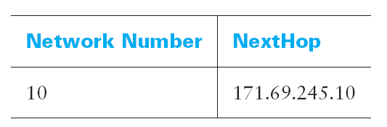
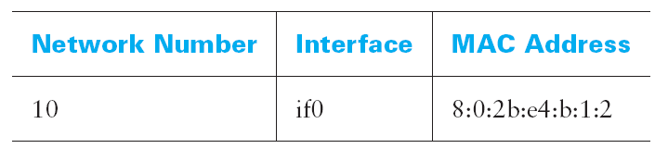
Routing Table vs. Forwarding Table
Routing Table
Forwarding Table
Notes:
While the terms forwarding table and routing table are sometimes used interchangeably, we will make a distinction between them here. The forwarding table is used when a packet is being forwarded and so must contain enough information to accomplish the forwarding function. This means that a row in the forwarding table contains the mapping from a network number to an outgoing interface and some MAC information, such as the Ethernet address of the next hop. The routing table, on the other hand, is the table that is built up by the routing algorithms as a precursor to building the forwarding table. It generally contains mappings from network numbers to next hops. It may also contain information about how this information was learned, so that the router will be able to decide when it should discard some information.

Slide 10
Routing Table vs. Forwarding Table
We restate an important distinction, which is often neglected, between forwarding and routing.
Forwarding consists of taking a packet, looking at its destination address, consulting a table, and sending the packet in a direction determined by that table.
Routing is the process by which forwarding tables are built. We also note that forwarding is a relatively simple and well-defined process performed locally at a node, whereas routing depends on complex distributed algorithms that have continued to evolve throughout the history of networking.
Notes:
While the terms forwarding table and routing table are sometimes used interchangeably, we will make a distinction between them here. The forwarding table is used when a packet is being forwarded and so must contain enough information to accomplish the forwarding function. This means that a row in the forwarding table contains the mapping from a network number to an outgoing interface and some MAC information, such as the Ethernet address of the next hop. The routing table, on the other hand, is the table that is built up by the routing algorithms as a precursor to building the forwarding table. It generally contains mappings from network numbers to next hops. It may also contain information about how this information was learned, so that the router will be able to decide when it should discard some information.

Slide 11
Circuit Switched vs Packet Switched
In “Circuit Switched” networks the control packet needs to find its way to the destination and all subsequent packets follow the same path.
In “Packet Switched” networks all packets have to find their way to the destination independently
Notes:
Dynamic routing algorithms change the routing paths as the network traffic loads or topology change. A dynamic algorithm can be run either periodically or in direct response to topology or link cost changes. While dynamic algorithms are more responsive to network changes, they are also more susceptible to problems such as routing loops and oscillation in routes.

Slide 12
Dynamic or Adaptive Routing
“Dynamic routing”, requires
each router to communicate routing information
with neighbors using a routing protocol
While dynamic algorithms are more responsive to network changes, they are also more susceptible to problems such as routing loops and oscillation in routes.

Slide 13
Internet-scale Routing Protocol
A single routing protocol does not suffice for two reasons
1) Scale – one entry for every host on the Internet?
2) Administrative autonomy – one entity to manage all?
Solution: Autonomous Systems (AS)
Intuitively - one corporation
Each AS chooses its own routing protocol
Notes:
Scale: As the number of routers becomes large, the overhead involved in computing, storing, and communicating routing information becomes prohibitive. Today’s public Internet consists of hundreds of millions of hosts. Storing routing information to each of these hosts will require enormous amounts of memory.
The bandwidth overhead required for building the routing table will leave no bandwidth for actual transmission of data. Clearly, something must be done to reduce the complexity of route computation in networks as large as the public Internet.

Slide 14
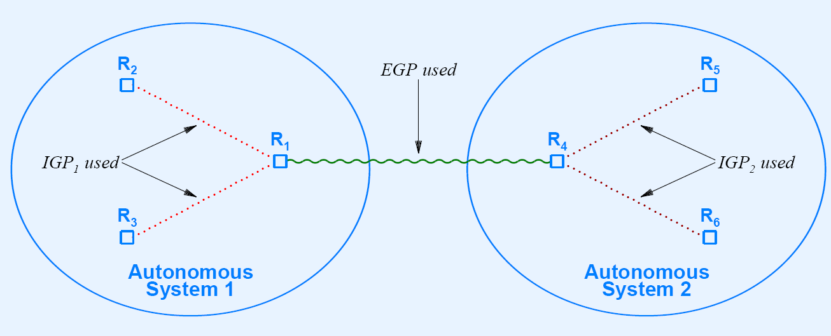
Classification of Routing Protocols
IGPs (Intra-AS) and EGPs (Inter-AS)
Interior Gateway Protocol (IGP): Intra-AS
Subject of this week’s lecture
Exterior Gateway Protocol (EGP): Inter-AS
Routing protocols that are designed to run on routers under one administrative domain (autonomous systems) are called Interior Gateway Protocols (IGPs) and those that run between routers of different AS are called Exterior Gateway Protocols (EGPs).
Notes:
Before getting into the details of routing, we need to remind ourselves of the key question we should be asking anytime we try to build a mechanism for the Internet: “Does this solution scale?” The answer for the algorithms and protocols described in this lecture is no. They are designed for networks of fairly modest size—fewer than a hundred nodes, in practice. However, the solutions we describe do serve as a building block for a hierarchical routing infrastructure that is used in the Internet today. Specifically, the protocols described in this section are collectively known as intra-domain routing protocols, or interior gateway protocols (IGPs). To understand these terms, we need to define a routing domain: A good working definition is an internetwork in which all the routers are under the same administrative control (e.g., a single university campus or the network of a single Internet service provider). The relevance of this definition will become apparent in the next section when we look at inter-domain routing protocols. For now, the important thing to keep in mind is that we are considering the problem of routing in the context of small to midsized networks, not for a network the size of the Internet.

Slide 15
Routing Classification Summary
Intra-AS Routing
Routing Algorithms
Inter-AS Routing
Distance-Vector Routing
Example: RIP
Link-State Routing
Example: OSPF
To be covered in future lectures
Example: BGP

Slide 16
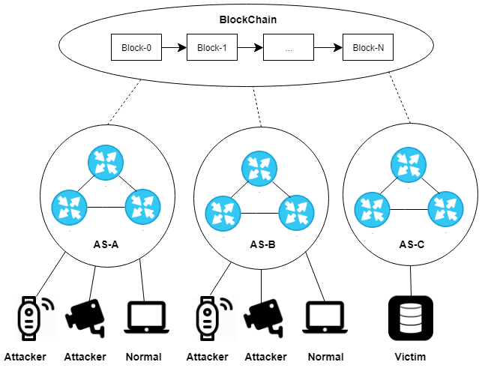

Slide 17
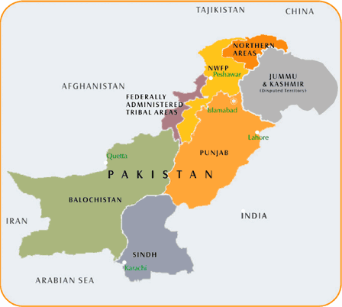
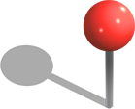
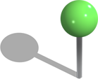
Network’s Graph Representation
1
3
4
2
Notes:
The idea behind the distance-vector algorithm is suggested by its name: Each node constructs a one-dimensional array (a vector) containing the “distances” (costs) to all other nodes and distributes that vector to its immediate neighbors. The starting assumption for distance-vector routing is that each node knows the cost of the link to each of its directly connected neighbors. A link that is down is assigned an infinite cost.

Slide 18
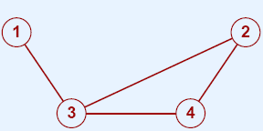
Network’s Graph Representation
G = (V,E)
Weighted
Edge
2
2
1
3
Node or Vertex

Slide 19
Distance Vector (DV) Routing
Notes:
The idea behind the distance-vector algorithm is suggested by its name: Each node constructs a one-dimensional array (a vector) containing the “distances” (costs) to all other nodes and distributes that vector to its immediate neighbors. The starting assumption for distance-vector routing is that each node knows the cost of the link to each of its directly connected neighbors. A link that is down is assigned an infinite cost.

Slide 20
Distance Vector (DV) Routing
DV: one-dimensional array containing distances (cost) to all other nodes
DVs initialized with costs of direct links and communicated with (direct) neighbors
When node x receives DV update from z, it checks if it can improve its current cost to y using Bellman-Ford equation
d_{x}(y) = minimum cost path between x and y
c(x, z) = cost of link between x and z
d_{x}(y) = min {d_{x}(y), (c(x, z) + d_{z}(y))}
Notes:
The idea behind the distance-vector algorithm is suggested by its name: Each node constructs a one-dimensional array (a vector) containing the “distances” (costs) to all other nodes and distributes that vector to its immediate neighbors. The starting assumption for distance-vector routing is that each node knows the cost of the link to each of its directly connected neighbors. A link that is down is assigned an infinite cost.

Slide 21
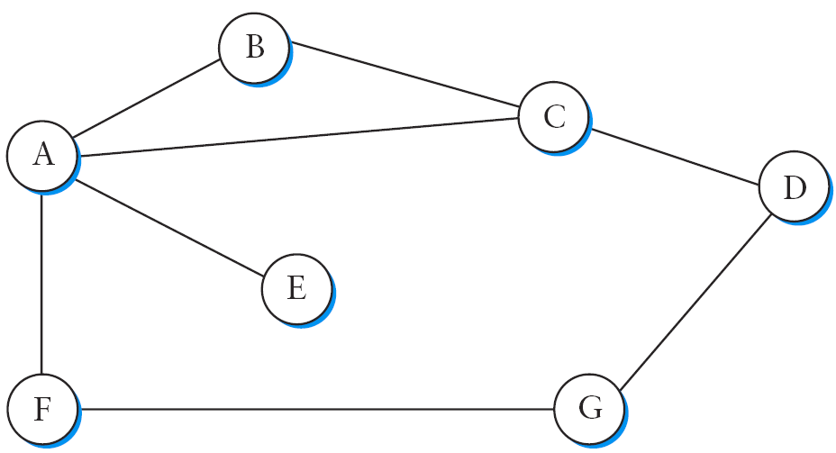
DV Example - Network Graph
` `
Cost for each link can be set
Notes:
Routing is, in essence, a problem of graph theory. The figure above shows a graph representing a network. The nodes of the graph, labeled A through F, may be either hosts, switches, routers, or networks. For our initial discussion, we will focus on the case where the nodes are routers. The edges of the graph correspond to the network links. Each edge has an associated cost, which gives some indication of the desirability of sending traffic over that link.
The basic problem of routing is to find the lowest-cost path between any two nodes, where the cost of a path equals the sum of the costs of all the edges that make up the path. For a simple network like the one shown above, you could imagine just calculating all the shortest paths and loading them into some nonvolatile storage on each node. Such a static approach has several shortcomings:
It does not deal with node or link failures.
■ It does not consider the addition of new nodes or links.
■ It implies that edge costs cannot change, even though we might reasonably wish to temporarily assign a high cost to a link that is heavily loaded.
For these reasons, routing is achieved in most practical networks by running routing protocols among the nodes. These protocols provide a distributed, dynamic way to solve the problem of finding the lowest-cost path in the presence of link and node failures and changing edge costs. Note the word “distributed” in the last sentence: It is difficult to make centralized solutions scalable, so all the widely used routing protocols use distributed algorithms.
The distributed nature of routing algorithms is one of the main reasons why this has been such a rich field of research and development—there are a lot of challenges in making distributed algorithms work well. For example, distributed algorithms raise the possibility that two routers will at one instant have different ideas about the shortest path to some destination. In fact, each one may think that the other one is closer to the destination, and decide to send packets to the other one. Clearly, such packets will be stuck in a loop until the discrepancy between the two routers is resolved, and it would be good to resolve it as soon as possible. This is just one example of the type of problem routing protocols must address. To begin our analysis, we assume that the edge costs in the network are known. We will examine the two main classes of routing protocols: distance vector and link state.
To see how a distance-vector routing algorithm works, it is easiest to consider an example like the one depicted in the Figure above. In this example, the cost of each link is set to 1, so that a least-cost path is simply the one with the fewest hops. (Since all edges have the same cost, we do not show the costs in the graph.)

Slide 22
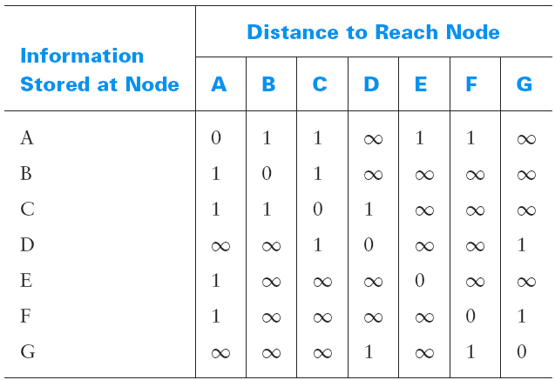
Distance Vector Routing Example
Initial information at each node
Notes:
We can represent each node’s knowledge about the distances to all other nodes as a table like the one given in Table 4.5. Note that each node only knows the information in one row of the table (the one that bears its name in the left column). The global view that is presented here is not available at any single point in the network.
We may consider each row in the Table above as a list of distances from one node to all other nodes, representing the current beliefs of that node. Initially, each node sets a cost of 1 to its directly connected neighbors and∞to all other nodes. Thus, A initially believes that it can reach B in one hop and that D is unreachable. The routing table stored at A reflects this set of beliefs and includes the name of the next hop that A would use to reach any reachable node. Initially, then, A’s routing table would look like Table 4.6.

Slide 23
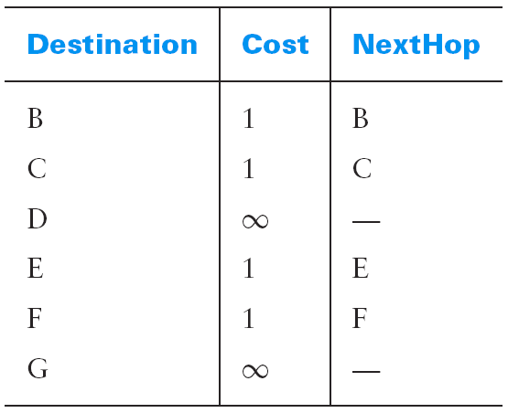
Distance Vector Routing Example
Initial Table at A
Notes:
Initially, then, A’s routing table would look like the Table above.
The next step in distance-vector routing is that every node sends a message to its directly connected neighbors containing its personal list of distances. For example, node F tells node A that it can reach node G at a cost of 1; A also knows it can reach F at a cost of 1, so it adds these costs to get the cost of reaching G by means of F. This total cost of 2 is less than the current cost of infinity, so A records that it can reach G at a cost of 2 by going through F. Similarly, A learns from C that D can be reached from C at a cost of 1; it adds this to the cost of reaching C (1) and decides that D can be reached via C at a cost of 2, which is better than the old cost of infinity. At the same time, A learns from C that B can be reached from C at a cost of 1, so it concludes that the cost of reaching B via C is 2. Since this is worse than the current cost of reaching B (1), this new information is ignored.

Slide 24
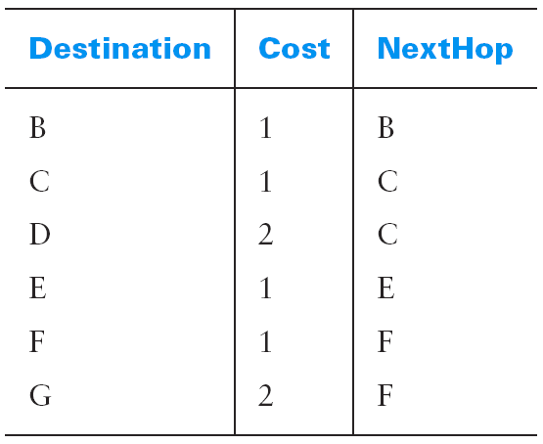
Distance Vector Routing Example
No change
C tells A that it can reach B at cost 1
changed
C tells A that it can reach D at cost 1
changed
F tells A that it can reach G at cost 1
Notes:
At this point, A can update its routing table with costs and next hops for all nodes in the network. The result is shown in the Table above.
In the absence of any topology changes, it only takes a few exchanges of information between neighbors before each node has a complete routing table. The process of getting consistent routing information to all the nodes is called convergence.

Slide 25
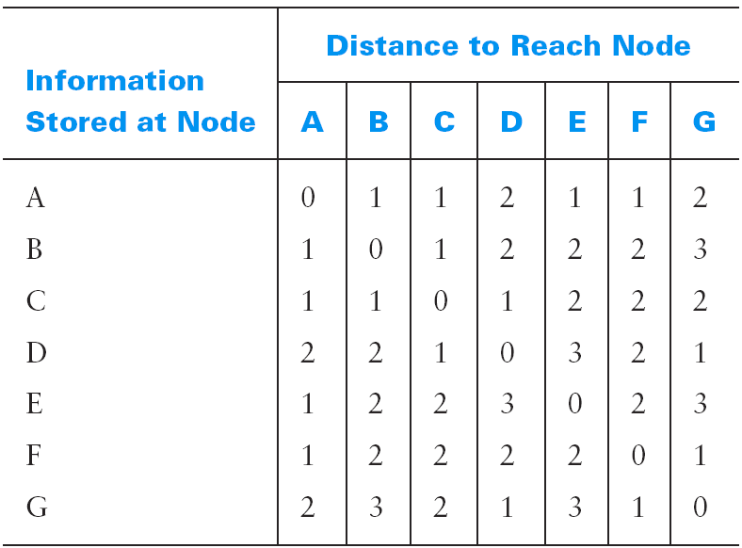
Distance Vector Routing Example
Final information
Notes:
Table 4.8 shows the final set of costs from each node to all other nodes when routing has converged. We must stress that there is no one node in the network that has all the information in this table—each node only knows about the contents of its own routing table. The beauty of a distributed algorithm like this is that it enables all nodes to achieve a consistent view of the network in the absence of any centralized authority.
There are a few details to fill in before our discussion of distance-vector routing is complete. First we note that there are two different circumstances under which a given node decides to send a routing update to its neighbors. One of these circumstances is the periodic update. In this case, each node automatically sends an update message every so often, even if nothing has changed. This serves to let the other nodes know that this node is still running. It also makes sure that they keep getting information that they may need if their current routes become unviable. The frequency of these periodic updates varies from protocol to protocol, but it is typically on the order of several seconds to several minutes. The second mechanism, sometimes called a triggered update, happens whenever a node receives an update from one of its neighbors that causes it to change one of the routes in its routing table. That is, whenever a node’s routing table changes, it sends an update to its neighbors, which may lead to a change in their tables, causing them to send an update to their neighbors.

Slide 26
Distance Vector Protocol: Updates
Routing updates: Periodic or Triggered
What happens when nodes/ links fail ?
I can reach G with cost 2
I can reach G with cost ∞
I can reach G with cost 1
Notes:
Now consider what happens when a link or node fails. The nodes that notice first send new lists of distances to their neighbors, and normally the system settles down fairly quickly to a new state. As to the question of how a node detects a failure, there are a couple of different answers.
In one approach, a node continually tests the link to another node by sending a control packet and seeing if it receives an acknowledgment. In another approach, a node determines that the link (or the node at the other end of the link) is down if it does not receive the expected periodic routing update for the last few update cycles. To understand what happens when a node detects a link failure, consider what happens when F detects that its link to G has failed. First, F sets its new distance to G to infinity and passes that information along to A. Since A knows that its 2-hop path to G is through F, A would also set its distance to G to infinity. However, with the next update from C, A would learn that C has a 2-hop path to G. Thus A would know that it could reach G in 3 hops through C, which is less than infinity, and so A would update its table accordingly. When it advertises this to F, node F would learn that it can reach G at a cost of 4 through A, which is less than infinity, and the system would again become stable.

Slide 27
Count to Infinity problem
I can reach E with cost 2 through A
I can reach E with cost 4 through A
I can reach E with cost 3 through B
I can reach E directly (cost 1)
This begins a count to infinity
Solution:
Smaller number representing ∞ (typically 16)
Don’t advertise back where you learnt from - Split Horizon
Notes:
Unfortunately, slightly different circumstances can prevent the network from stabilizing. Suppose, for example, that the link from A to E goes down. In the next round of updates, A advertises a distance of infinity to E, but B and C advertise a distance of 2 to E. Depending on the exact timing of events, the following might happen: Node B, upon hearing that E can be reached in 2 hops from C, concludes that it can reach E in 3 hops and advertises this to A; node A concludes that it can reach E in 4 hops and advertises this to C; node C concludes that it can reach E in 5 hops; and so on. This cycle stops only when the distances reach some number that is large enough to be considered infinite. In the meantime, none of the nodes actually knows that E is unreachable, and the routing tables for the network do not stabilize. This situation is known as the count-to-infinity problem.
There are several partial solutions to this problem. The first one is to use some relatively small number as an approximation of infinity. For example, we might decide that the maximum number of hops to get across a certain network is never going to be more than 16, and so we could pick 16 as the value that represents infinity. This at least bounds the amount of time that it takes to count to infinity. Of course, it could also present a problem if our network grew to a point where some nodes were separated by more than 16 hops.
One technique to improve the time to stabilize routing is called split horizon. The idea is that when a node sends a routing update to its neighbors, it does not send those routes it learned from each neighbor back to that neighbor. For example, if B has the route (E, 2, A) in its table, then it knows it must have learned this route from A, and so whenever B sends a routing update to A, it does not include the route (E, 2) in that update. In a stronger variation of split horizon, called split horizon with poison reverse, B actually sends that route back to A, but it puts negative information in the route to ensure that A will not eventually use B to get to E. For example, B sends the route (E, ∞) to A. The problem with both of these techniques is that they only work for routing loops that involve two nodes. For larger routing loops, more drastic measures are called for. Continuing the above example, if B and C had waited for a while after hearing of the link failure from A before advertising routes to E, they would have found that neither of them really had a route to E. Unfortunately, this approach delays the convergence of the protocol; speed of convergence is one of the key advantages of its competitor, link-state routing, the subject of Section 4.2.3.

Slide 28
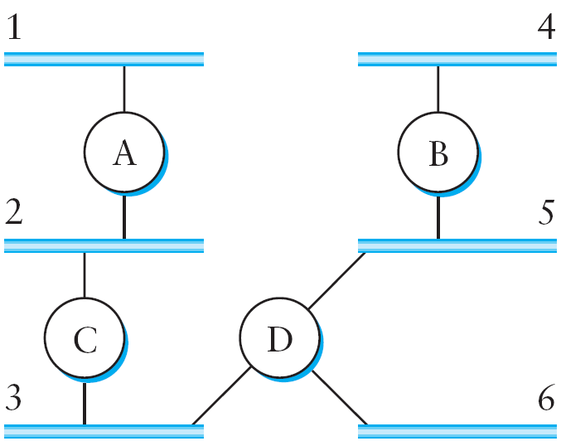
Routing Information Protocol (RIP)
Router C would advertise to router A the fact that it can reach networks 2 and 3 (to which it is directly connected) at a cost of 0; networks 5 and 6 at cost 1; and network 4 at cost 2.
C advertises to A
Nets 2 and 3 at cost 0; Nets 5 and 6 at cost 1; Net 4 at cost 2
Distance Vector based Routing Protocol
Notes:
One of the most widely used routing protocols in IP networks is the Routing Information Protocol (RIP). Its widespread use is due in no small part to the fact that it was distributed along with the popular Berkeley Software Distribution (BSD) version of Unix, from which many commercial versions of Unix were derived. It is also extremely simple. RIP is the canonical example of a routing protocol built on the distance-vector algorithm just described.
Routing protocols in internetworks differ very slightly from the idealized graph model described above. In an internetwork, the goal of the routers is to learn how to forward packets to various networks. Thus, rather than advertising the cost of reaching other routers, the routers advertise the cost of reaching networks. For example, in the figure above, router C would advertise to router A the fact that it can reach networks 2 and 3 (to which it is directly connected) at a cost of 0; networks 5 and 6 at cost 1; and network 4 at cost 2.

Slide 29
Exercise: Design a routing protocol that enables routers A, B, C and D route packets from various connected networks. Your protocol should work differently from the one studied in last session. Provide:
Define information exchange between routers
What information is exchanged?
How do routers populate their routing tables?
Once the routers know about the entire network, show how a packet that starts from network 4 ends up at network 3

Slide 30
Topic’s objectives
To learn about:
Link state routing
Inter AS routing
Notes:
In last week lectures, we had discussed why a single routing protocol does not scale to the size of Internet due to scaling and administrative autonomy issues.
In today’s lecture we are going to cover two important topics.
1) The first being that how do we exchange routing information between different autonomous systems (AS) that may potentially be using totally different interior gateway (IGP) routing protocols. As we will see in this lecture, the issue of inter-AS routing (or interdomain routing, as it is also known) is quite challenging.
We will also cover the most popular exterior gateway routing protocol (EGP) of the Internet – BGP. BGP is virtually the only EGP used to exchange routing information between different AS on the Internet. It’s quite a complex protocol and it is not our intention to discuss BGP in all its detail today.
We will instead focus on the basics of BGP so that you can understand how inter-AS routing works. Interested students may want to look up this topic independently since BGP is perhaps the most important Internet routing protocol.
2) We will focus on a technology that is very commonly used in the core networks driving today’s Internet. This technology, called MPLS, was designed to alleviate some of the overheads associated with plain IP forwarding which requires population of routing/ forwarding tables and then longest-prefix matches.
While, the primary aim of MPLS is to improve the switching/ routing speed of packets through the core network, it has some other advantages as well as we will see (which includes easy VPN creation, explicit route definition, and traffic engineering).

Slide 31
DV Vs. LS
In distance vector, each node talks only to its directly connected neighbors, but it tells them everything it has learned (i.e., distance to all nodes). In link state, each node talks to all other nodes, but it tells them only what it knows for sure (i.e., only the state of its directly connected links).
Notes:
In distance vector routing, a router need not know the entire path to every network segment; it only requires to know the direction or vector in which to send the packet. The technique determines the direction (vector) and distance (hop count) to any network in the internetwork.
In link-state routing, each router attempt to construct its own internal map of the entire network topology.

Slide 32
Part I –
Link State Routing Protocol

Slide 33
Link State Routing Protocol
Nodes know the state of directly connected links
Flood link-state-packets (and not entire routing tables) to entire network (and not just neighbors)
Collection of link-states present entire network map
Each node calculates shortest paths in these maps
Link State Packet (LSP):
Creating node’s ID; Cost to each (direct) neighbor; SEQ no; TTL
Notes:
Reliable flooding is the process of making sure that all the nodes participating in the routing protocol get a copy of the link-state information from all the other nodes. As the term “flooding” suggests, the basic idea is for a node to send its link-state information out on all of its directly connected links, with each node that receives this information forwarding it out on all of its links. This process continues until the information has reached all the nodes in the network.
The figure above shows an LSP being flooded in a small network. Each node becomes shaded as it stores the new LSP. In Fig (a) the LSP arrives at node X, which sends it to neighbors A and C in Fig 4.18(b). A and C do not send it back to X, but send it on to B. Since B receives two identical copies of the LSP, it will accept whichever arrived first and ignore the second as a duplicate. It then passes the LSP on to D, who has no neighbors to flood it to, and the process is complete.
Just as in RIP, each node generates LSPs under two circumstances. Either the expiry of a periodic timer or a change in topology can cause a node to generate a new LSP. However, the only topology-based reason for a node to generate an LSP is if one of its directly connected links or immediate neighbors has gone down. The failure of a link can be detected in some cases by the link-layer protocol. The demise of a neighbor or loss of connectivity to that neighbor can be detected using periodic “hello” packets. Each node sends these to its immediate neighbors at defined intervals. If a sufficiently long time passes without receipt of a “hello” from a neighbor, the link to that neighbor will be declared down, and a new LSP will be generated to reflect this fact. One of the important design goals of a link-state protocol’s flooding mechanism is that the newest information must be flooded to all nodes as quickly as possible, while old information must be removed from the network and not allowed to circulate. In addition, it is clearly desirable to minimize the total amount of routing traffic that is sent around the network; after all, this is just “overhead” from the perspective of those who actually use the network for their applications. The next few paragraphs describe some of the ways that these goals are accomplished.
One easy way to reduce overhead is to avoid generating LSPs unless absolutely necessary. This can be done by using very long timers—often on the order of hours—for the periodic generation of LSPs. Given that the flooding protocol is truly reliable when topology changes, it is safe to assume that messages saying “nothing has changed” do not need to be sent very often.
To make sure that old information is replaced by newer information, LSPs carry sequence numbers. Each time a node generates a new LSP, it increments the sequence number by 1. Unlike most sequence numbers used in protocols, these sequence numbers are not expected to wrap, so the field needs to be quite large (say, 64 bits). If a node goes down and then comes back up, it starts with a sequence number of 0. If the node was down for a long time, all the old LSPs for that node will have timed out (as described below); otherwise, this node will eventually receive a copy of its own LSP with a higher sequence number, which it can then increment and use as its own sequence number. This will ensure that its new LSP replaces any of its old LSPs left over from before the node went down. LSPs also carry a time to live. This is used to ensure that old link-state information is eventually removed from the network. A node always decrements the TTL of a newly received LSP before flooding it to its neighbors. It also “ages” the LSP while it is stored in the node. When the TTL reaches 0, the node refloods the LSP with a TTL of 0, which is interpreted by all the nodes in the network as a signal to delete that LSP.

Slide 34
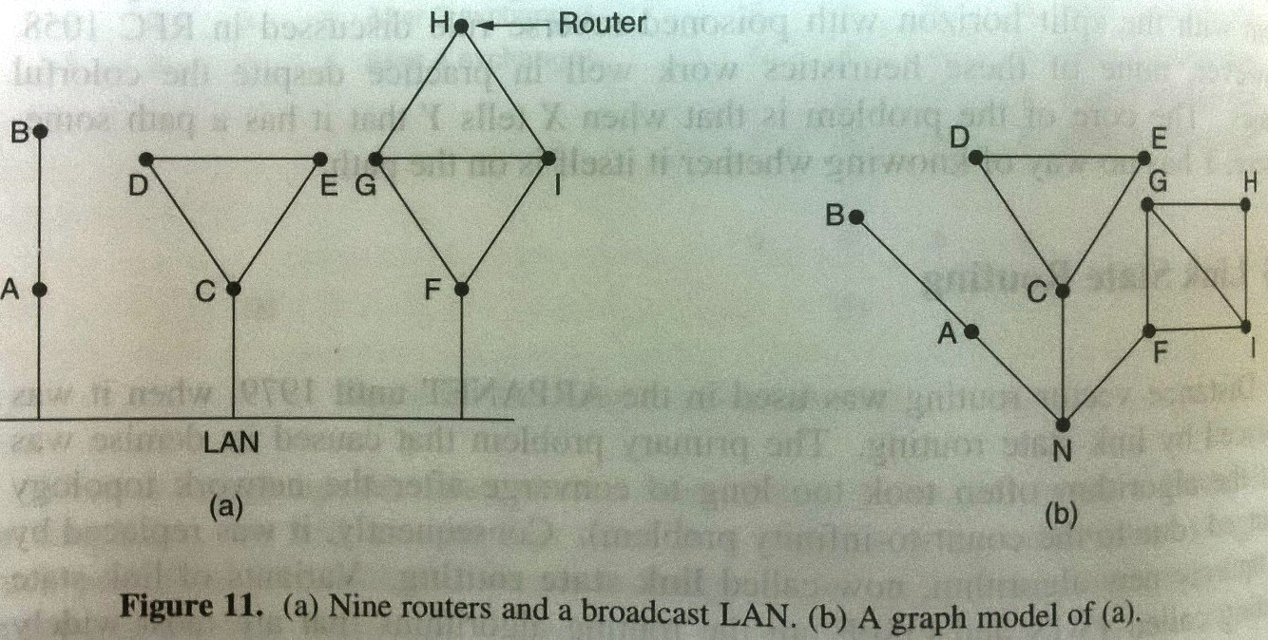
Link State Routing Protocol
Learning about the neighbors: Done though Hello messages
Notes:
Reliable flooding is the process of making sure that all the nodes participating in the routing protocol get a copy of the link-state information from all the other nodes. As the term “flooding” suggests, the basic idea is for a node to send its link-state information out on all of its directly connected links, with each node that receives this information forwarding it out on all of its links. This process continues until the information has reached all the nodes in the network.
Kurose and Ross
The figure above shows an LSP being flooded in a small network. Each node becomes shaded as it stores the new LSP. In Fig (a) the LSP arrives at node X, which sends it to neighbors A and C in Fig 4.18(b). A and C do not send it back to X, but send it on to B. Since B receives two identical copies of the LSP, it will accept whichever arrived first and ignore the second as a duplicate. It then passes the LSP on to D, who has no neighbors to flood it to, and the process is complete.
Just as in RIP, each node generates LSPs under two circumstances. Either the expiry of a periodic timer or a change in topology can cause a node to generate a new LSP. However, the only topology-based reason for a node to generate an LSP is if one of its directly connected links or immediate neighbors has gone down. The failure of a link can be detected in some cases by the link-layer protocol. The demise of a neighbor or loss of connectivity to that neighbor can be detected using periodic “hello” packets. Each node sends these to its immediate neighbors at defined intervals. If a sufficiently long time passes without receipt of a “hello” from a neighbor, the link to that neighbor will be declared down, and a new LSP will be generated to reflect this fact. One of the important design goals of a link-state protocol’s flooding mechanism is that the newest information must be flooded to all nodes as quickly as possible, while old information must be removed from the network and not allowed to circulate. In addition, it is clearly desirable to minimize the total amount of routing traffic that is sent around the network; after all, this is just “overhead” from the perspective of those who actually use the network for their applications. The next few paragraphs describe some of the ways that these goals are accomplished.
One easy way to reduce overhead is to avoid generating LSPs unless absolutely necessary. This can be done by using very long timers—often on the order of hours—for the periodic generation of LSPs. Given that the flooding protocol is truly reliable when topology changes, it is safe to assume that messages saying “nothing has changed” do not need to be sent very often.
To make sure that old information is replaced by newer information, LSPs carry sequence numbers. Each time a node generates a new LSP, it increments the sequence number by 1. Unlike most sequence numbers used in protocols, these sequence numbers are not expected to wrap, so the field needs to be quite large (say, 64 bits). If a node goes down and then comes back up, it starts with a sequence number of 0. If the node was down for a long time, all the old LSPs for that node will have timed out (as described below); otherwise, this node will eventually receive a copy of its own LSP with a higher sequence number, which it can then increment and use as its own sequence number. This will ensure that its new LSP replaces any of its old LSPs left over from before the node went down. LSPs also carry a time to live. This is used to ensure that old link-state information is eventually removed from the network. A node always decrements the TTL of a newly received LSP before flooding it to its neighbors. It also “ages” the LSP while it is stored in the node. When the TTL reaches 0, the node refloods the LSP with a TTL of 0, which is interpreted by all the nodes in the network as a signal to delete that LSP.

Slide 35
Link State Routing Protocol
Nodes know the state of directly connected links
Flood link-state-packets (and not entire routing tables) to entire network (and not just neighbors)
Collection of link-states present entire network map
Each node calculates shortest paths in these maps
Link State Packet (LSP):
Creating node’s ID; Cost to each (direct) neighbor; SEQ no; TTL
Notes:
Reliable flooding is the process of making sure that all the nodes participating in the routing protocol get a copy of the link-state information from all the other nodes. As the term “flooding” suggests, the basic idea is for a node to send its link-state information out on all of its directly connected links, with each node that receives this information forwarding it out on all of its links. This process continues until the information has reached all the nodes in the network.
The figure above shows an LSP being flooded in a small network. Each node becomes shaded as it stores the new LSP. In Fig (a) the LSP arrives at node X, which sends it to neighbors A and C in Fig 4.18(b). A and C do not send it back to X, but send it on to B. Since B receives two identical copies of the LSP, it will accept whichever arrived first and ignore the second as a duplicate. It then passes the LSP on to D, who has no neighbors to flood it to, and the process is complete.
Just as in RIP, each node generates LSPs under two circumstances. Either the expiry of a periodic timer or a change in topology can cause a node to generate a new LSP. However, the only topology-based reason for a node to generate an LSP is if one of its directly connected links or immediate neighbors has gone down. The failure of a link can be detected in some cases by the link-layer protocol. The demise of a neighbor or loss of connectivity to that neighbor can be detected using periodic “hello” packets. Each node sends these to its immediate neighbors at defined intervals. If a sufficiently long time passes without receipt of a “hello” from a neighbor, the link to that neighbor will be declared down, and a new LSP will be generated to reflect this fact. One of the important design goals of a link-state protocol’s flooding mechanism is that the newest information must be flooded to all nodes as quickly as possible, while old information must be removed from the network and not allowed to circulate. In addition, it is clearly desirable to minimize the total amount of routing traffic that is sent around the network; after all, this is just “overhead” from the perspective of those who actually use the network for their applications. The next few paragraphs describe some of the ways that these goals are accomplished.
One easy way to reduce overhead is to avoid generating LSPs unless absolutely necessary. This can be done by using very long timers—often on the order of hours—for the periodic generation of LSPs. Given that the flooding protocol is truly reliable when topology changes, it is safe to assume that messages saying “nothing has changed” do not need to be sent very often.
To make sure that old information is replaced by newer information, LSPs carry sequence numbers. Each time a node generates a new LSP, it increments the sequence number by 1. Unlike most sequence numbers used in protocols, these sequence numbers are not expected to wrap, so the field needs to be quite large (say, 64 bits). If a node goes down and then comes back up, it starts with a sequence number of 0. If the node was down for a long time, all the old LSPs for that node will have timed out (as described below); otherwise, this node will eventually receive a copy of its own LSP with a higher sequence number, which it can then increment and use as its own sequence number. This will ensure that its new LSP replaces any of its old LSPs left over from before the node went down. LSPs also carry a time to live. This is used to ensure that old link-state information is eventually removed from the network. A node always decrements the TTL of a newly received LSP before flooding it to its neighbors. It also “ages” the LSP while it is stored in the node. When the TTL reaches 0, the node refloods the LSP with a TTL of 0, which is interpreted by all the nodes in the network as a signal to delete that LSP.

Slide 36
Dijkstra’s (SPT) Algorithm
This algorithm calculates the shortest path tree given any graph
1 Initialization:
2 N’ = {u}
3 for all nodes v
4 if v adjacent to u {
5 D(v) = c(u,v) //set as least cost path from u to v
6 else D(v) = ∞ // not adjacent
7
8 Loop
9 find w not in N’ with the smallest D(w) // from init
10 add w to N’
11 update D(v) for all v adjacent to w and not in N’:
12 D(v) = min{D(v), D(w) + c(w,v)}
13 until all nodes in N’
Source node
Cost of v to get to source u
Notes:
Once a given node has a copy of the LSP from every other node, it is able to compute a complete map for the topology of the network, and from this map it is able to decide the best route to each destination. The question, then, is exactly how it calculates routes from this information. The solution is based on a well-known algorithm from graph theory—Dijkstra’s shortest-path algorithm.

Slide 37
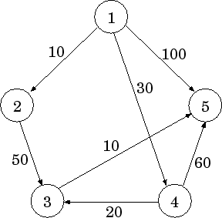
 | N’ | D(2) | D(3) | D(4) | D(5)
Initial | {1} | 10 | ∞ | 30 | 100
1 | {1,2} | 10 | 60 | 30 | 100
2 | {1,2,4} | 10 | 50 | 30 | 90
3 | {1,2,4,3} | 10 | 50 | 30 | 60
4 | {1,2,4,3,5} | 10 | 50 | 30 | 60
http://www.acm.org/conferences/sac/sac2000/Proceed/FinalPapers/DB-05/node3.html

Slide 38
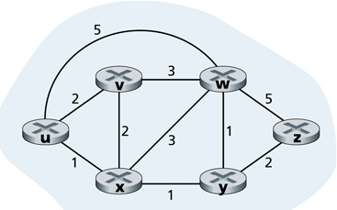
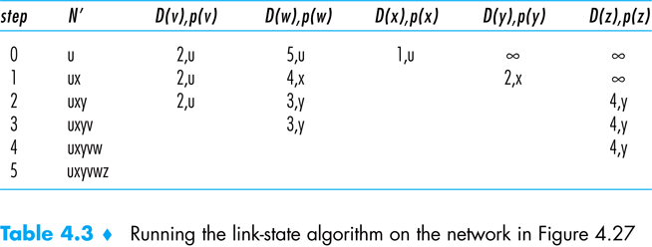
Dijkstra’s Algorithm Exercise

Slide 39
Dijkstra’s (SPT) Algorithm

Slide 40
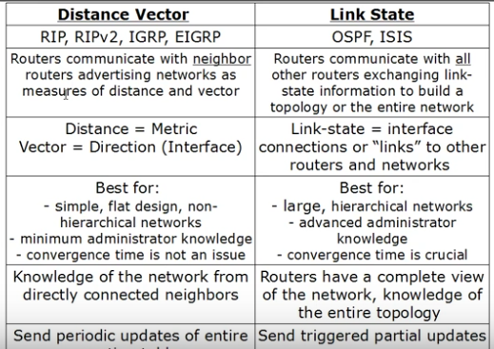
LS Vs. DV
Notes:
https://techdifferences.com/difference-between-distance-vector-routing-and-link-state-routing.html

Slide 41
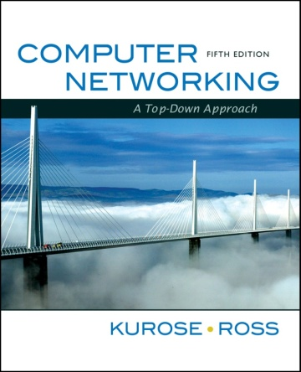
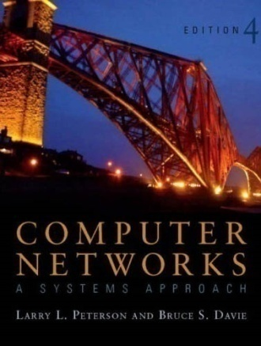
References
Chapter 4:
The Network Layer [K&R]
Section 4.5 and 4.6 (in particular)
Chapter 4:
Internetworking [P&D]
Section 4.2

Slide 42
[ End of lecture ]

